Slide 1

Retailing In Electronic Commerce: Products and Services

Slide 2
Learning Objectives
Describe electronic retailing (e-tailing) and its characteristics.
Classify the primary e-tailing business models.
Describe how online travel and tourism services operate and their impact on the industry.
Discuss the online employment market, including its participants, benefits, and limitations.
Describe online real estate services.
Discuss online stock-trading services.
Copyright © 2012 Pearson Education, Inc. Publishing as Prentice Hall
3-<number>

Slide 3
Learning Objectives
Discuss cyberbanking and online personal finance.
Describe on-demand delivery of groceries and similar perishable products and services related to them.
Describe the delivery of digital products and online entertainment.
Discuss various online consumer aids, including comparison-shopping aids.
Describe disintermediation and other B2C strategic issues.
Copyright © 2012 Pearson Education, Inc. Publishing as Prentice Hall
3-<number>

Slide 4
Internet Marketing and B2C Electronic Retailing
electronic retailing (e-tailing)
Retailing conducted online, over the Internet
e-tailers
Retailers who sell over the Internet
Copyright © 2012 Pearson Education, Inc. Publishing as Prentice Hall
3-<number>

Slide 5
Internet Marketing and B2C Electronic Retailing
CHARACTERISTICS AND ADVANTAGES OF SUCCESSFUL E-TAILING
  Brand name recognition
  Digitized format
  Relatively inexpensive items
  Frequently purchased items
Copyright © 2012 Pearson Education, Inc. Publishing as Prentice Hall
3-<number>

Slide 6
E-Tailing Business Models
CLASSIFICATION OF MODELS BY DISTRIBUTION CHANNEL
  Direct marketing by mail-order retailers that go online
  Direct marketing by manufacturers
  Pure-play e-tailers
  Click-and-mortar retailers
    multichannel business model
    A business model where a company sells in multiple marketing channels simultaneously (e.g., both physical and online stores)
  Internet (online) malls
Copyright © 2012 Pearson Education, Inc. Publishing as Prentice Hall
3-<number>

Slide 7
E-Tailing Business Models
  direct marketing
  Broadly, marketing that takes place without intermediaries between manufacturers and buyers; in the context of this book, marketing done online between any seller and buyer
Copyright © 2012 Pearson Education, Inc. Publishing as Prentice Hall
3-<number>

Slide 8
E-Tailing Business Models
  Direct Sales by Manufacturers
  virtual (pure-play) e-tailers
  Firms that sell directly to consumers over the Internet without maintaining a physical sales channel
  click-and-mortar retailers
  Brick-and-mortar retailers that offer a transactional website from which to conduct business
  brick-and-mortar retailers
  Retailers who do business in the non-Internet, physical world in traditional brick-and-mortar stores
Copyright © 2012 Pearson Education, Inc. Publishing as Prentice Hall
3-<number>

Slide 9
E-Tailing Business Models
  Retailing in Online Malls
    Referring Directories
    Malls with Shared Services
Copyright © 2012 Pearson Education, Inc. Publishing as Prentice Hall
3-<number>

Slide 10
E-Tailing Business Models
OTHER B2C MODELS AND SPECIAL RETAILING
B2C SOCIAL SHOPPING
  Online Group Buying
  Personalized Event Shopping
    event shopping
    A B2C model in which sales are done to meet the needs of special events (e.g., a wedding, Black Friday).
  private shopping club
  A members-only shopping club, where members can buy goods at large discounts
Copyright © 2012 Pearson Education, Inc. Publishing as Prentice Hall
3-<number>

Slide 11
E-Tailing Business Models
  Group Gifting Online
  location-based e-commerce (l-commerce)
  Delivery of e-commerce transactions to individuals in a specific location, at a specific time
  Shopping in Virtual Worlds
VIRTUAL VISUAL SHOPPING
Copyright © 2012 Pearson Education, Inc. Publishing as Prentice Hall
3-<number>

Slide 12
Employment and the Online Job Market
PARTIES WHO USE THE INTERNET JOB MARKET
    Job seekers
    Employers seeking employees
    Classified ads
    Job agencies
    Government agencies and institutions
  Online Job Markets on Social Networks
  Global Online Portals for Job Placement
  Virtual Job Fairs
Copyright © 2012 Pearson Education, Inc. Publishing as Prentice Hall
3-<number>

Slide 13
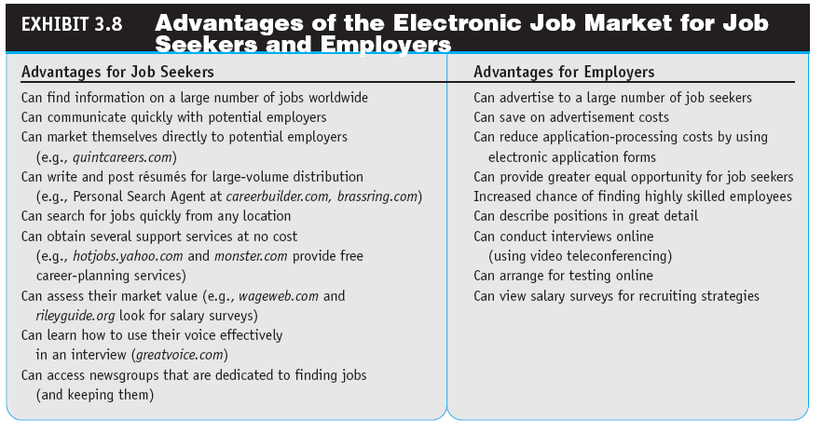
Copyright © 2012 Pearson Education, Inc. Publishing as Prentice Hall
3-<number>

Slide 14
ONLINE REAL ESTATE, INSURANCE, AND STOCK TRADING
REAL ESTATE ONLINE
  Zillow, Craigslist, and Other Web 2.0 Real Estate Services
INSURANCE ONLINE
ONLINE STOCK TRADING
  The Risk of Trading in an Online Stock Account
Copyright © 2012 Pearson Education, Inc. Publishing as Prentice Hall
3-<number>

Slide 15
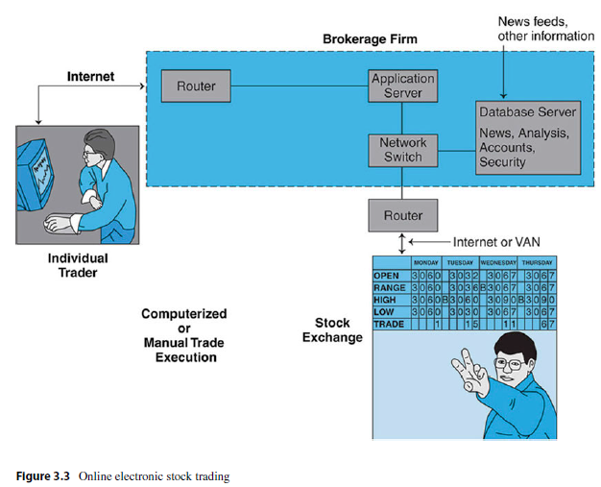
Copyright © 2012 Pearson Education, Inc. Publishing as Prentice Hall
3-<number>

Slide 16
ONLINE BANKING AND PERSONAL FINANCE
electronic (online) banking or e-banking
Various banking activities conducted from home or the road using an Internet connection; also known as cyberbanking, virtual banking, online banking, and home banking
Copyright © 2012 Pearson Education, Inc. Publishing as Prentice Hall
3-<number>

Slide 17
Banking and
Personal Finance Online
ONLINE FINANCIAL TRANSACTION IMPLEMENTATION ISSUES
  Securing Financial Transactions
  Imaging Systems
  Fees Online Versus Fees for Offline Services
  Risks
ONLINE BILLING AND BILL PAYING
  Taxes
Copyright © 2012 Pearson Education, Inc. Publishing as Prentice Hall
3-<number>

Slide 18
On-Demand Delivery of Products,
Digital Items, Entertainment, and Gaming
ON-DEMAND DELIVERY OF PRODUCTS
  e-grocer
  A grocer that takes orders online and provides deliveries on a daily or other regular schedule or within a very short period of time
  on-demand delivery service
  Express delivery made fairly quickly after an online order is received
Copyright © 2012 Pearson Education, Inc. Publishing as Prentice Hall
3-<number>

Slide 19
On-Demand Delivery of Products,
Digital Items, Entertainment, and Gaming
ONLINE DELIVERY OF DIGITAL PRODUCTS, ENTERTAINMENT, AND MEDIA
ONLINE ENTERTAINMENT
  Internet Gaming
  Online Ticketing
Copyright © 2012 Pearson Education, Inc. Publishing as Prentice Hall
3-<number>

Slide 20
Online Purchasing-Decision Aids
PRICE AND QUALITY COMPARISON BY SHOPBOT SOFTWARE AGENTS
  shopping robots (shopping agents or shopbots)
  Tools that scout the Web on behalf of consumers who specify search criteria
Google Enterprise Search and Enterprise Search Appliance
“Spy” Services
Copyright © 2012 Pearson Education, Inc. Publishing as Prentice Hall
3-<number>

Slide 21
Online Purchasing-Decision Aids
BUSINESS RATINGS SITES
  Recommendations from Other Shoppers and Friends
    referral economy
    The effect upon sales of consumers receiving a referral or recommendation from other consumers.
TRUST VERIFICATION SITES
Copyright © 2012 Pearson Education, Inc. Publishing as Prentice Hall
3-<number>

Slide 22
THE NEW FACE OF RETAIL COMPETITION: RETAILERS VERSUS E-TAILERS
The Online Versus Offline Competition: An Overview
  Customers’ search cost.
  Delivery time.
  Distribution costs.
  Tax differences.
  Price.
  Information available to buyers.
Copyright © 2012 Pearson Education, Inc. Publishing as Prentice Hall
3-<number>

Slide 23
THE NEW FACE OF RETAIL COMPETITION: RETAILERS VERSUS E-TAILERS
Retailers Versus E-Tailers
Since the beginning of EC in the mid 1990s, it has become clear that in certain industries, e-tailing will hurt brick and mortar retailers.
Today, Amazon.com is competing with thousands of retailers,
Copyright © 2012 Pearson Education, Inc. Publishing as Prentice Hall
3-<number>

Slide 24
THE NEW FACE OF RETAIL COMPETITION: RETAILERS VERSUS E-TAILERS
What Can Traditional Retailers Do?
In addition to opening online channels, and closing the least profitable stores, traditional companies have a few strategies to defend themselves.
Copyright © 2012 Pearson Education, Inc. Publishing as Prentice Hall
3-<number>

Slide 25
THE NEW FACE OF RETAIL COMPETITION: RETAILERS VERSUS E-TAILERS
Here are representative examples:
  Can Small Businesses Survive?
  Here are some strategies:
    Niche markets
    Faster delivery than Amazon
    Protect privacy. Amazon tracks customers’ movements on the Web
    Concentrate on local markets
    Provide outstanding customer service
    Prices should be competitive.
    Going Global!
Copyright © 2012 Pearson Education, Inc. Publishing as Prentice Hall
3-<number>

Slide 26
Issues In E-Tailing and Lessons Learned
The following are to be addressed when conducting B2C EC
  disintermediation
The removal of organizations or business process layers responsible for certain intermediary steps in a given supply chain
  reintermediation
The process whereby intermediaries (either new ones or those that had been disintermediated) take on new intermediary roles
Copyright © 2012 Pearson Education, Inc. Publishing as Prentice Hall
3-<number>

Slide 27
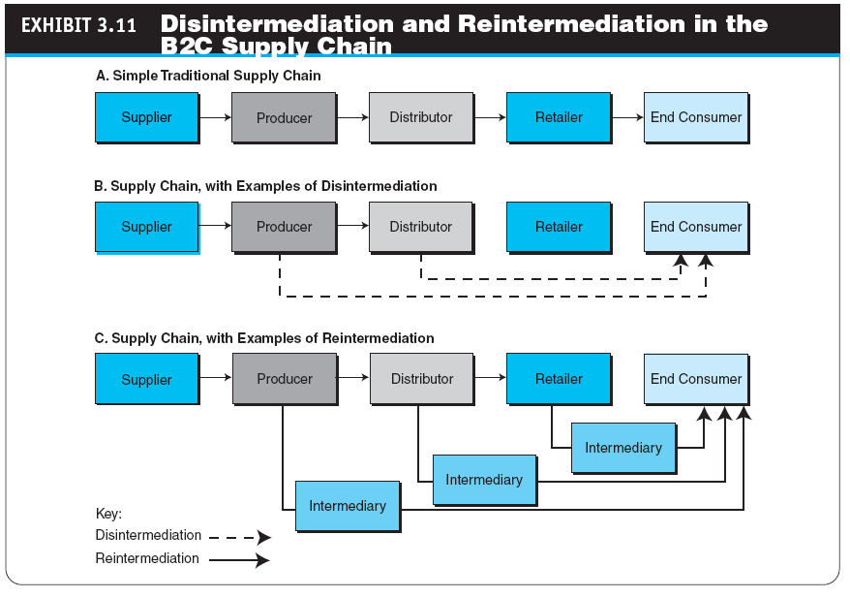
Copyright © 2012 Pearson Education, Inc. Publishing as Prentice Hall
3-<number>

Slide 28
Issues In E-Tailing and Lessons Learned
channel conflict
Situation in which an online marketing channel upsets the traditional channels due to real or perceived damage from competition
Copyright © 2012 Pearson Education, Inc. Publishing as Prentice Hall
3-<number>

Slide 29
Issues In E-Tailing and Lessons Learned
POSSIBILITY OF A PRICE CONFLICT AND DETERMINING THE RIGHT PRICE BY SELLERS
PRODUCT AND SERVICE CUSTOMIZATION AND PERSONALIZATION
ONLINE COMPETITION
FRAUD AND OTHER ILLEGAL ACTIVITIES
Copyright © 2012 Pearson Education, Inc. Publishing as Prentice Hall
3-<number>

Slide 30
Issues In E-Tailing and Lessons Learned
LESSONS LEARNED FROM FAILURES AND LACK OF SUCCESS OF E-TAILERS
  Speak with one voice
  Leverage the multichannels
  Empower the customer
Copyright © 2012 Pearson Education, Inc. Publishing as Prentice Hall
3-<number>

Slide 31
Managerial Issues
What are the limitations of e-tailing? Where is e-tailing going?
How should we introduce wireless shopping?
Do we have ethics and privacy guidelines?
How will intermediaries act in cyberspace?
Should we try to capitalize on social networks?
How should we manage multichannel marketing to avoid channel and/or price conflicts?
What are the major potential limitations of the growth of B2C EC?
Copyright © 2012 Pearson Education, Inc. Publishing as Prentice Hall
3-<number>

Slide 32
Summary
The scope and characteristics of e-tailing
Classify e-tailing business models
How online travel/tourism services operate
The online job market and its benefits
The electronic real estate marketplace
Online trading of stocks and bonds
Copyright © 2012 Pearson Education, Inc. Publishing as Prentice Hall
3-<number>

Slide 33
Summary
Cyberbanking and personal finance
On-demand delivery service
Delivery of digital products
Aiding consumer purchase decisions
Disintermediation and other B2C strategic issues
Copyright © 2012 Pearson Education, Inc. Publishing as Prentice Hall
3-<number>

Slide 34

All rights reserved. No part of this publication may be reproduced, stored in a retrieval system, or transmitted, in any form or by any means, electronic, mechanical, photocopying, recording, or otherwise, without the prior written permission of the publisher. Printed in the United States of America.
Copyright © 2012 Pearson Education, Inc.
Publishing as Prentice Hall
Copyright © 2012 Pearson Education, Inc. Publishing as Prentice Hall
3-<number>

